Slide 1
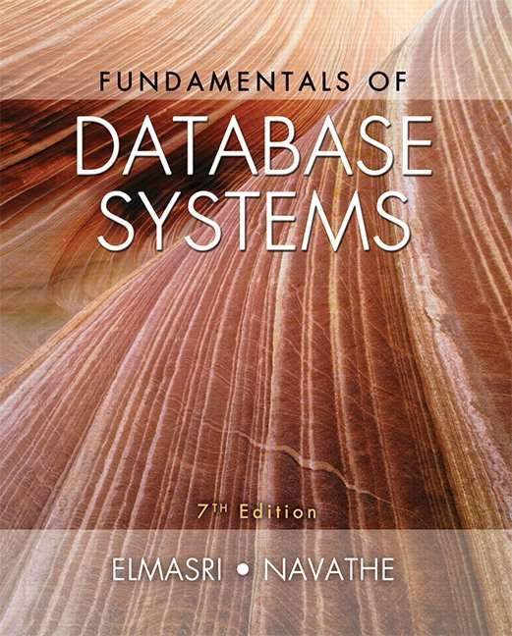
Copyright © 2016 Ramez Elmasri and Shamkant B. Navathe

Slide 2
CHAPTER 6
Basic SQL
Slide 6- 2

Slide 3
Chapter 6 Outline
SQL Data Definition and Data Types
Specifying Constraints in SQL
Basic Retrieval Queries in SQL
INSERT, DELETE, and UPDATE Statements in SQL
Additional Features of SQL
Slide 6- 3

Slide 4
Basic SQL
SQL language
Considered one of the major reasons for the commercial success of relational databases
SQL
The origin of SQL is relational predicate calculus called tuple calculus (see Ch.8) which was proposed initially as the language SQUARE.
SQL Actually comes from the word “SEQUEL” which was the original term used in the paper: “SEQUEL TO SQUARE” by Chamberlin and Boyce. IBM could not copyright that term, so they abbreviated to SQL and copyrighted the term SQL.
Now popularly known as “Structured Query language”.
SQL is an informal or practical rendering of the
Corpyerighlta© 2t0i1o6 Rnamaez Ellmdasari antdaShammkanot Bd. Naevatlhewith syntax
Slide 6- 4

Slide 5
SQL Data Definition, Data Types, Standards
Terminology:
Table, row, and column used for relational model terms relation, tuple, and attribute
CREATE statement
Main SQL command for data definition
The language has features for :
Data definition (DDL)
Data Manipulation (DML)
Transaction control
Indexing
Security specification (Grant and Revoke)
Slide 6- 5

Slide 6
Schema and Catalog Concepts in SQL
We cover the basic standard SQL syntax – there are variations in existing RDBMS systems
SQL schema
Identified by a schema name
Includes an authorization identifier and descriptors
for each element
Schema elements include
Tables, constraints, views, domains, and other constructs
Each statement in SQL ends with a semicolon
Slide 6- 6

Slide 7
Schema and Catalog Concepts in SQL (cont’d.)
CREATE SCHEMA statement
CREATE SCHEMA COMPANY AUTHORIZATION ‘Jsmith’;
Catalog
Named collection of schemas in an SQL environment
SQL also has the concept of a cluster of catalogs.
Slide 6- 7

Slide 8
The CREATE TABLE Command in SQL
Specifying a new relation
Provide name of table
Specify attributes, their types and initial constraints
Can optionally specify schema:
CREATE TABLE COMPANY.EMPLOYEE ...
or
CREATE TABLE EMPLOYEE ...
Slide 6- 8

Slide 9
The CREATE TABLE Command in SQL (cont’d.)
Base tables (base relations)
Relation and its tuples are actually created and stored as a file by the DBMS
Virtual relations (views)
Created through the CREATE VIEW statement. Do not correspond to any physical file.
Slide 6- 9
Notes:
Section 2, 4

Slide 10
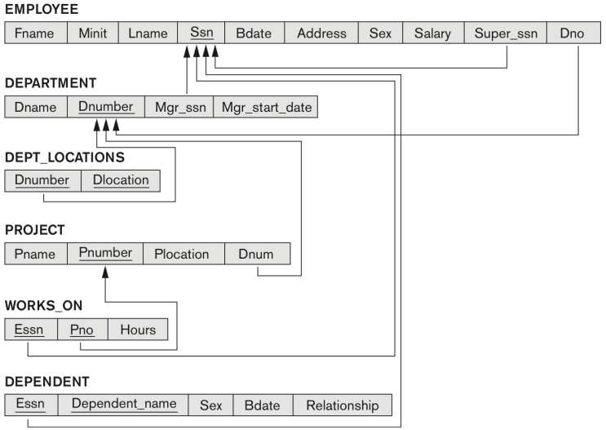
COMPANY relational database schema (Fig. 5.7)
Slide 6- 10

Slide 11
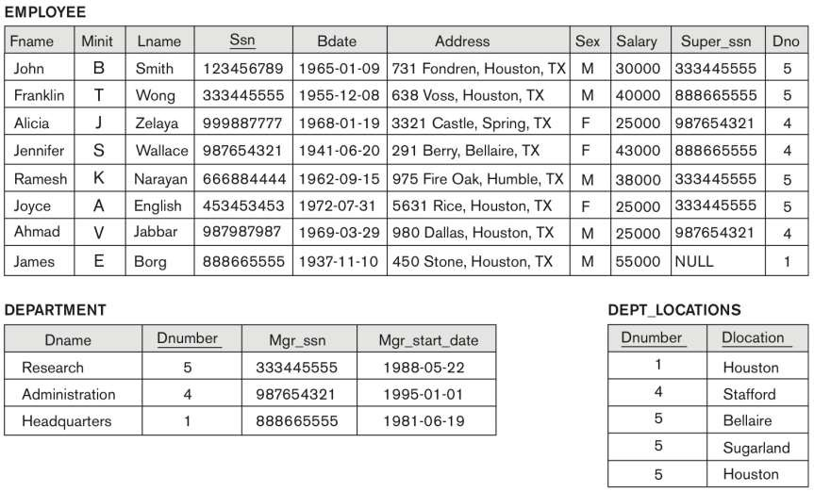
One possible database state for the COMPANY relational database schema (Fig. 5.6)
Slide 6- 11

Slide 12
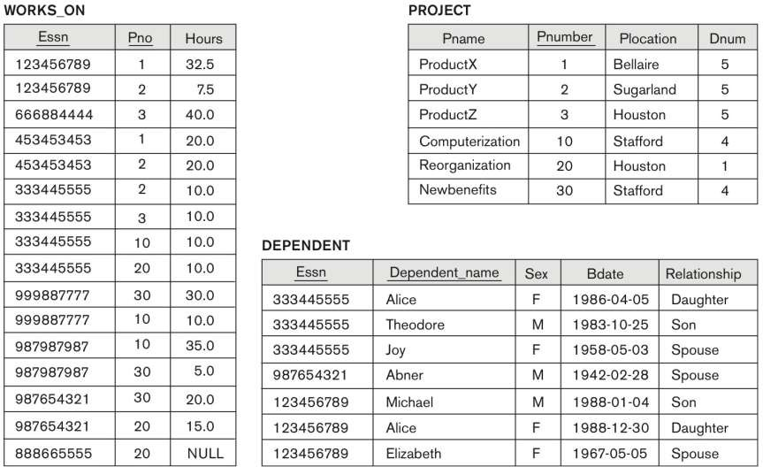
One possible database state for the COMPANY relational database schema – continued (Fig. 5.6)
Slide 6- 12

Slide 13
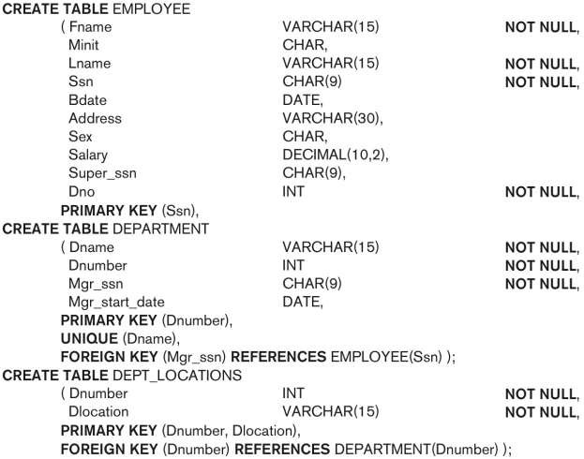
SQL CREATE TABLE data definition statements for defining the COMPANY schema from Figure 5.7 (Fig. 6.1)
continued on next slide
Slide 6- 13

Slide 14
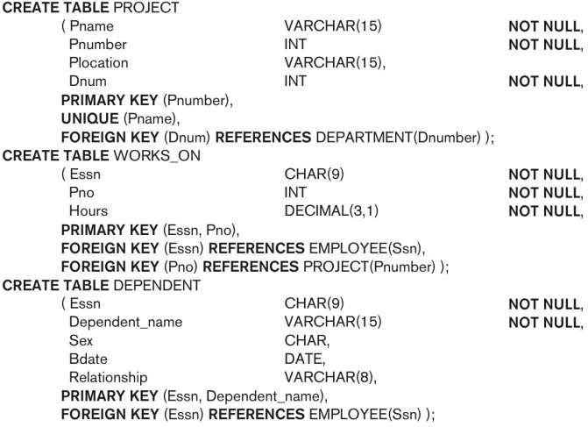
SQL CREATE TABLE data definition statements for defining the COMPANY schema from Figure 5.7 (Fig. 6.1)-continued
Slide 6- 14

Slide 15
Attribute Data Types and Domains in SQL
Basic data types
Numeric data types
Integer numbers: INTEGER, INT, and SMALLINT
Floating-point (real) numbers: FLOAT or REAL, and
DOUBLE PRECISION
Character-string data types
Fixed length: CHAR(n), CHARACTER(n)
Varying length: VARCHAR(n), CHAR VARYING(n), CHARACTER VARYING(n)

Slide 16
Attribute Data Types and Domains in SQL (cont’d.)
Bit-string data types
Fixed length: BIT(n)
Varying length: BIT VARYING(n)
Boolean data type
Values of TRUE or FALSE or NULL
DATE data type
Ten positions
Components are YEAR, MONTH, and DAY in the form YYYY-MM-DD
Multiple mapping functions available in RDBMSs to change date formats

Slide 17
Attribute Data Types and Domains in SQL (cont’d.)
Additional data types
Timestamp data type
Includes the DATE and TIME fields
Plus a minimum of six positions for decimal fractions of seconds
Optional WITH TIME ZONE qualifier
INTERVAL data type
Specifies a relative value that can be used to increment or decrement an absolute value of a date, time, or timestamp
DATE, TIME, Timestamp, INTERVAL data types can be cast or converted to string formats for comparison.

Slide 18
Attribute Data Types and Domains in SQL (cont’d.)
Domain
Name used with the attribute specification
Makes it easier to change the data type for a domain that is used by numerous attributes
Improves schema readability
Example:
CREATE DOMAIN SSN_TYPE AS CHAR(9);
TYPE
User Defined Types (UDTs) are supported for object-oriented applications. (See Ch.12) Uses the
command:
CREATE TYPE

Slide 19
Specifying Constraints in SQL
Basic constraints:
Relational Model has 3 basic constraint types that are supported in SQL:
Key constraint: A primary key value cannot be duplicated
Entity Integrity Constraint: A primary key value cannot be null
Referential integrity constraints : The “foreign key “ must have a value that is already present as a primary key, or may be null.

Slide 20
Specifying Attribute Constraints
Other Restrictions on attribute domains:
Default value of an attribute
DEFAULT <value>
NULL is not permitted for a particular attribute (NOT NULL)
CHECK clause
Dnumber INT NOT NULL CHECK (Dnumber >
0 AND Dnumber < 21);

Slide 21
Specifying Key and Referential Integrity Constraints
PRIMARY KEY clause
Specifies one or more attributes that make up the primary key of a relation
Dnumber INT PRIMARY KEY;
UNIQUE clause
Specifies alternate (secondary) keys (called CANDIDATE keys in the relational model).
Dname VARCHAR(15) UNIQUE;

Slide 22
Specifying Key and Referential Integrity Constraints (cont’d.)
Some FOREIGN KEYs may cause errors such as:
Circular references: For example, the foreign key Super_ssn in the EMPLOYEE table is a circular reference because it refers to the table itself.
Or because they refer to a table that has not yet been created: For example, the foreign key Dno in the EMPLOYEE table refers to the DEPARTMENT table, which has not been created yet.
Default operation: These constraints can be left out of the initial CREATE TABLE statement, and then added later using the ALTER TABLE statement
Notes:
Section 2, 4

Slide 23
Specifying Key and Referential Integrity Constraints (cont’d.)
FOREIGN KEY clause
Default operation: reject update on violation
Attach referential triggered action clause
Options include SET NULL, CASCADE, and SET
DEFAULT
Action taken by the DBMS for SET NULL or SET DEFAULT is the same for both ON DELETE and ON UPDATE
CASCADE option suitable for “relationship” relations

Slide 24
Giving Names to Constraints
Using the Keyword CONSTRAINT
Name a constraint, which must be a unique within a particular schema.
Useful for later altering
Useful for dropping the constraint

Slide 25
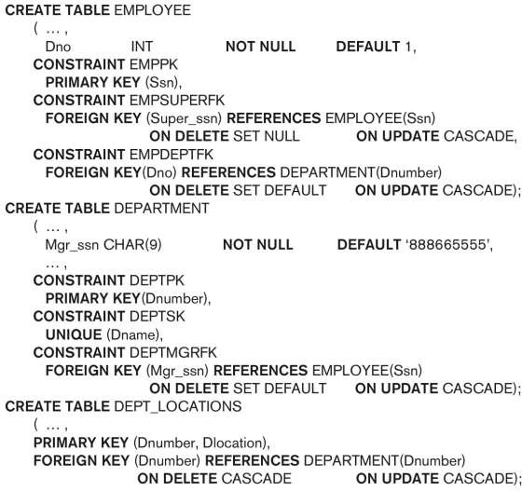
Default attribute values and referential integrity triggered action specification (Fig. 6.2)

Slide 26
Specifying Constraints on Tuples Using CHECK
Additional Constraints on individual tuples within a relation are also possible using CHECK
CHECK clauses at the end of a CREATE TABLE
statement
Apply to each tuple individually
CHECK (Dept_create_date <= Mgr_start_date);

Slide 27
DROP TABLE
Used to remove a relation (base table) and its definition
The relation can no longer be used in queries, updates, or any other commands since its description no longer exists
Examples:
- DROP TABLE DEPENDENT;
- DROP TABLE DEPENDENT CASCADE CONSTRAINTS;

Slide 28
ALTER TABLE
Used to :
1.Add an attribute to one of the base relations: Example: ALTER TABLE EMPLOYEE ADD JOB VARCHAR(12);
2. Modify an existing attribute in a base relation: Example: ALTER TABLE EMPLOYEE MODIFY JOB VARCHAR(20);
3. Drop an existing attribute from a base relation: Example: ALTER TABLE EMPLOYEE DROP COLUMN JOB;
4. Rename an existing attribute in a base relation: Example: ALTER TABLE EMPLOYEE RENAME COLUMN BDATE TO
BIRTH_DATE;

Slide 29
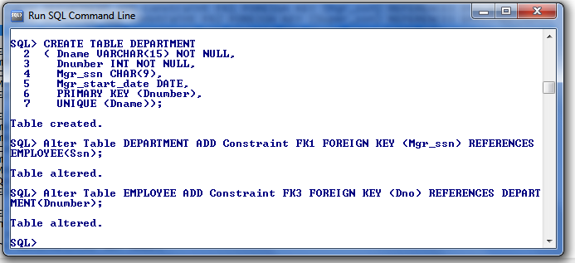
ALTER TABLE

Slide 30
Basic Retrieval Queries in SQL

Slide 31
Basic Retrieval Queries in SQL
SELECT statement
One basic statement for retrieving information from a database
SQL allows a table to have two or more tuples that are identical in all their attribute values
Unlike relational model (relational model is strictly set-theory based)
Multiset or bag behavior
Tuple-id may be used as a key

Slide 32
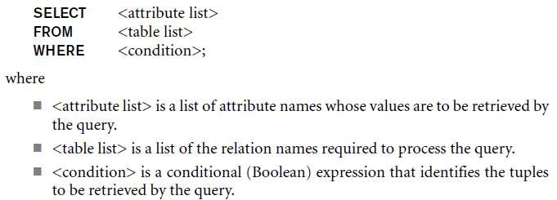
The SELECT-FROM-WHERE
Structure of Basic SQL Queries
Basic form of the SELECT statement:

Slide 33
The SELECT-FROM-WHERE Structure of Basic SQL Queries (cont’d.)
Logical comparison operators
■ =, <, <=, >, >=, and <>
Projection attributes
Attributes whose values are to be retrieved
Selection condition
Boolean condition that must be true for any retrieved tuple. Selection conditions include join conditions (see Ch.8) when multiple relations are involved.

Slide 34
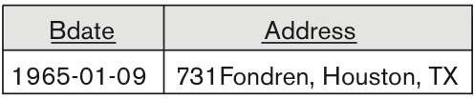
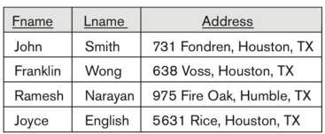
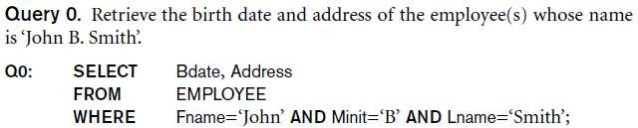
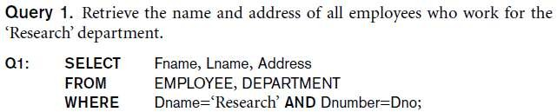
Basic Retrieval Queries

Slide 35

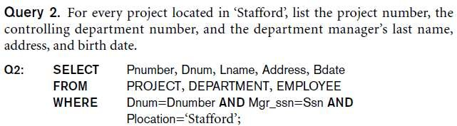
Basic Retrieval Queries (Contd.)
Notes:
Section 2

Slide 36

Ambiguous Attribute Names
Same name can be used for two (or more) attributes in different relations
As long as the attributes are in different relations
Must qualify the attribute name with the relation name to prevent ambiguity

Slide 37
Aliasing, and Renaming
Aliases or tuple variables
Declare alternative relation names E and S to refer to the EMPLOYEE relation twice in a query:
Query 8. For each employee, retrieve the employee’s first and last name and the first and last name of his or her immediate supervisor.
SELECT E.Fname, E.Lname, S.Fname, S.Lname
FROM EMPLOYEE AS E, EMPLOYEE AS S
■
WHERE E.Super_ssn=S.Ssn;
Recommended practice to abbreviate names and to prefix same or similar attribute from multiple tables.

Slide 38
Aliasing,Renaming and Tuple Variables (contd.)
The attribute names can also be renamed
EMPLOYEE AS E(Fn, Mi, Ln, Ssn, Bd,
Addr, Sex, Sal, Sssn, Dno)
Note that the relation EMPLOYEE now has a variable name E which corresponds to a tuple variable
The “AS” may be dropped in most SQL implementations

Slide 39
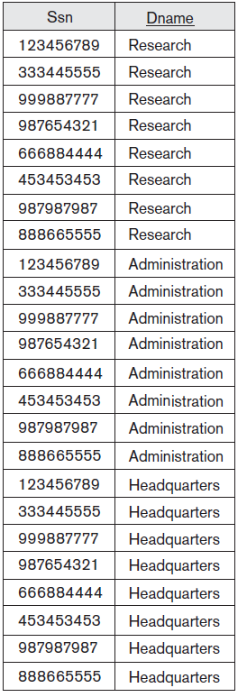
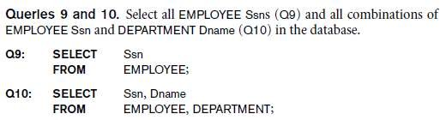
Unspecified WHERE Clause and Use of the Asterisk
Missing WHERE clause
Indicates no condition on tuple selection
Effect is a CROSS PRODUCT
Result is all possible tuple combinations
result

Slide 40
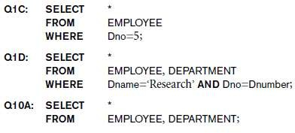
Unspecified WHERE Clause and Use of the Asterisk (cont’d.)
Specify an asterisk (*)
Retrieve all the attribute values of the selected tuples
The * can be prefixed by the relation name; e.g., EMPLOYEE *

Slide 41
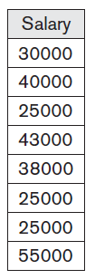
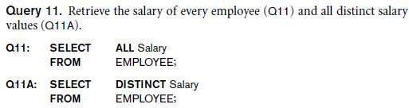

Tables as Sets in SQL
SQL does not automatically eliminate duplicate tuples in query results
For aggregate operations (See sec 7.1.7) duplicates must
be accounted for
Use the keyword DISTINCT in the SELECT clause
Only distinct tuples should remain in the result

Slide 42
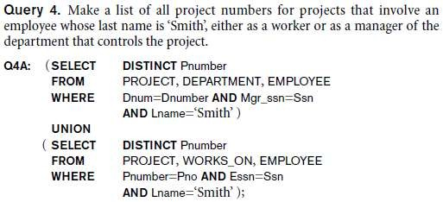
Tables as Sets in SQL (cont’d.)
Set operations
UNION, EXCEPT (difference), INTERSECT
Corresponding multiset operations: UNION ALL, EXCEPT ALL, INTERSECT ALL)
Type compatibility is needed for these operations to be valid

Slide 43
Substring Pattern Matching and Arithmetic Operators
LIKE comparison operator
Used for string pattern matching
% replaces an arbitrary number of zero or more characters
underscore (_) replaces a single character
Examples: WHERE Address LIKE ‘%Houston,TX%’;
WHERE Ssn LIKE ‘_ _ 1_ _ 8901’;
BETWEEN comparison operator
Examples: WHERE(Salary BETWEEN 30000 AND 4000) AND Dno = 5;
Notes:
section2

Slide 44
Substring Pattern Matching Examples
SELECT FNAME, LNAME, Salary FROM EMPLOYEE WHERE FName LIKE ‘A%‘;
SELECT FNAME, LNAME, Salary FROM EMPLOYEE WHERE FName LIKE ‘‘_ _A%‘;
SELECT FNAME, LNAME, Salary FROM EMPLOYEE WHERE FName LIKE ‘%A%‘;
SELECT FNAME, LNAME, Salary FROM EMPLOYEE WHERE FName LIKE ‘%A _ _‘;
SELECT FNAME, LNAME, Salary FROM EMPLOYEE WHERE FName LIKE ‘AB%‘;
SELECT FNAME, LNAME, Salary FROM EMPLOYEE WHERE FName LIKE ‘_ _ _‘;

Slide 45
Arithmetic Operations
Standard arithmetic operators:
Addition (+), subtraction (–), multiplication (*), and division (/) may be included as a part of SELECT
Query 13. Show the resulting salaries if every employee working on
the ‘ProductX’ project is given a 10 percent raise.
SELECT E.Fname, E.Lname, 1.1 * E.Salary AS Increased_sal
FROM EMPLOYEE AS E, WORKS_ON AS W, PROJECT AS P
WHERE E.Ssn=W.Essn AND W.Pno=P.Pnumber AND
P.Pname=‘ProductX’;

Slide 46
Ordering of Query Results
Use ORDER BY clause
Keyword DESC to see result in a descending order of values
Keyword ASC to specify ascending order explicitly
Typically placed at the end of the query
Example:
SELECT * FROM EMPLOYEE ORDER BY Lname ASC;
SELECT * FROM EMPLOYEE ORDER BY SALARY DESC

Slide 47
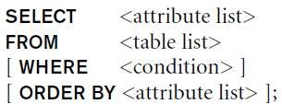
Basic SQL Retrieval Query Block

Slide 48
INSERT, DELETE, and UPDATE
Statements in SQL

Slide 49
INSERT, DELETE, and UPDATE
Statements in SQL
Three commands used to modify the database:
INSERT, DELETE, and UPDATE
INSERT typically inserts a tuple (row) in a relation (table)
UPDATE may update a value of attribute in a relation (table) that satisfy the condition
DELETE may also update a number of tuples (rows) in a relation (table) that satisfy the condition

Slide 50
INSERT
In its simplest form, it is used to add one or more tuples to a relation
Attribute values should be listed in the same order as the attributes were specified in the CREATE TABLE command
Constraints on data types are observed automatically
Any integrity constraints as a part of the DDL specification are enforced

Slide 51


The INSERT Command
Specify the relation name and a list of values for the tuple. All values including nulls are supplied.
INSERT INTO EMPLOYEE (FNAME, LNAME, SSN)
VALUES ('Richard', 'Marini', '653298653')

Slide 52

The INSERT Command
The variation below inserts multiple tuples where a new table is loaded values from the result of a query.

Slide 53
BULK LOADING OF TABLES
Another variation of INSERT is used for bulk-loading of several tuples into tables
A new table TNEW can be created with the same attributes as T and using LIKE and DATA in the syntax, it can be loaded with entire data.
EXAMPLE:
CREATE TABLE D5EMPS LIKE EMPLOYEE
(SELECT FROM WHERE
WITH DATA;
E.*
EMPLOYEE AS E
E.Dno=5)

Slide 54
DELETE
Removes tuples from a relation
Includes a WHERE-clause to select the tuples to be deleted
Referential integrity should be enforced
Tuples are deleted from only one table at a time (unless CASCADE is specified on a referential integrity constraint)
A missing WHERE-clause specifies that all tuples in the relation are to be deleted; the table then becomes an empty table
The number of tuples deleted depends on the number of tuples in the relation that satisfy the WHERE-clause

Slide 55
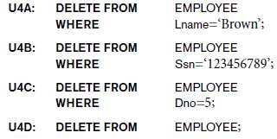
The DELETE Command
Removes tuples from a relation
Includes a WHERE clause to select the tuples to be deleted. The number of tuples deleted will vary.

Slide 56
UPDATE
Used to modify attribute values of one or more selected tuples
A WHERE-clause selects the tuples to be modified
An additional SET-clause specifies the attributes to be modified and their new values
Each command modifies tuples in the same relation
Referential integrity specified as part of DDL specification is enforced

Slide 57
UPDATE (contd.)
Example: Change the location and controlling department number of project number 10 to 'Bellaire' and 5, respectively
U5:
UPDATE SET
PROJECT
PLOCATION = 'Bellaire', DNUM = 5
PNUMBER=10
WHERE

Slide 58
UPDATE (contd.)
Example: Give all employees in the 'Research' department a 10% raise in salary.
U6:UPDATE SET WHERE
EMPLOYEE
SALARY = SALARY *1.1
DNO IN (SELECT DNUMBER
FROM DEPARTMENT
WHERE DNAME='Research')
In this request, the modified SALARY value depends on
the original SALARY value in each tuple
The reference to the SALARY attribute on the right of = refers to the old SALARY value before modification
The reference to the SALARY attribute on the left of = refers to the new SALARY value after modification

Slide 59
Summary
SQL
A Comprehensive language for relational database management
Data definition, queries, updates, constraint specification, and view definition
Covered :
Data definition commands for creating tables
Commands for constraint specification
Simple retrieval queries
■ Database update commands

